Slide 1
Did Election 2016 Break Campaign Finance?
Wesleyan Media Project Post-Election Conference
Prof. Jennifer Nicoll Victor
Schar School of Policy and Government
George Mason University
@jennifernvictor
December 5, 2016

Slide 2
Unconventional Election
Standard indicators did not predict the winner
Standard indicators predicted the candidate that got more votes
Money is increasingly prominent but is less deterministic
Campaign assets are increasingly difficult to track
Implications

Slide 3
Conventional indicators were unidirectional

Slide 4
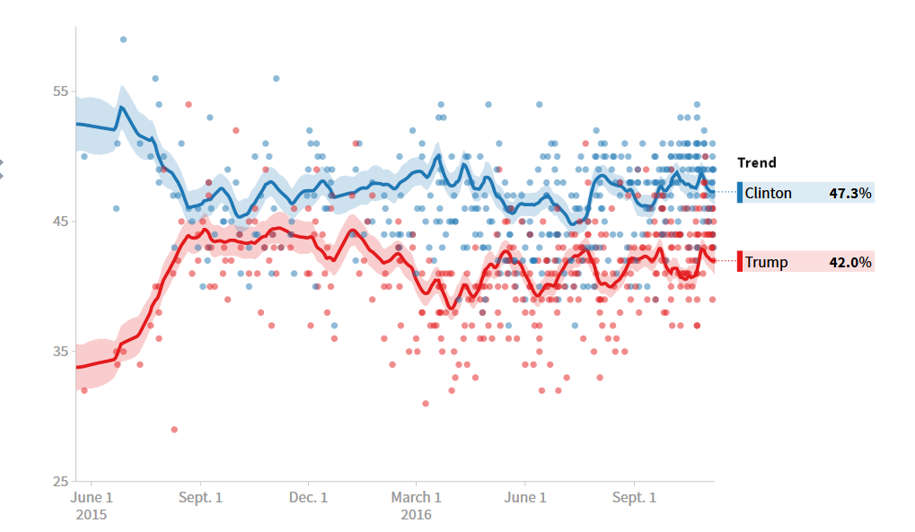
Clinton never trailed
(national aggregate)
Clinton won popular vote
Source: Pollster.com

Slide 5
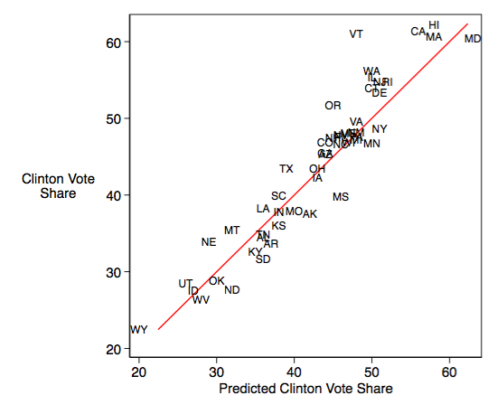
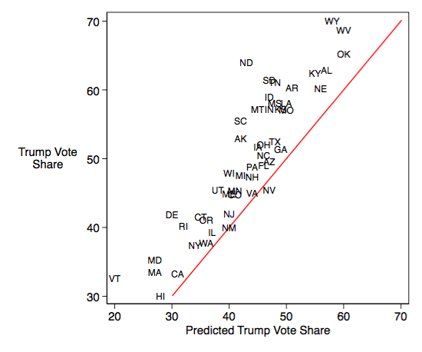
Polls were wrong
(Trump support; some states)
Polls are accurate predictors of Clinton vote
Polls consistently underestimate Trump vote
Source: @smotus, Mischiefs of Faction on Vox:

Slide 6
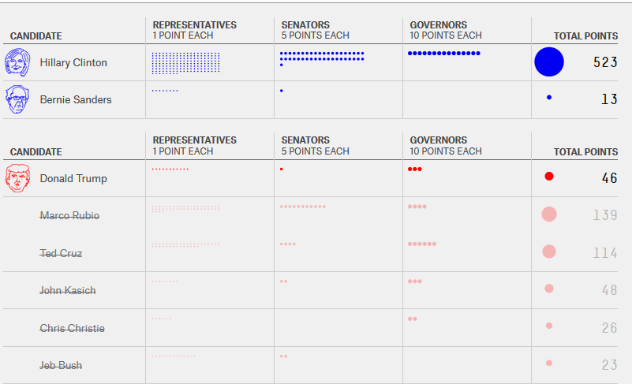
endorsements
Source: fivethirtyeight.com

Slide 7
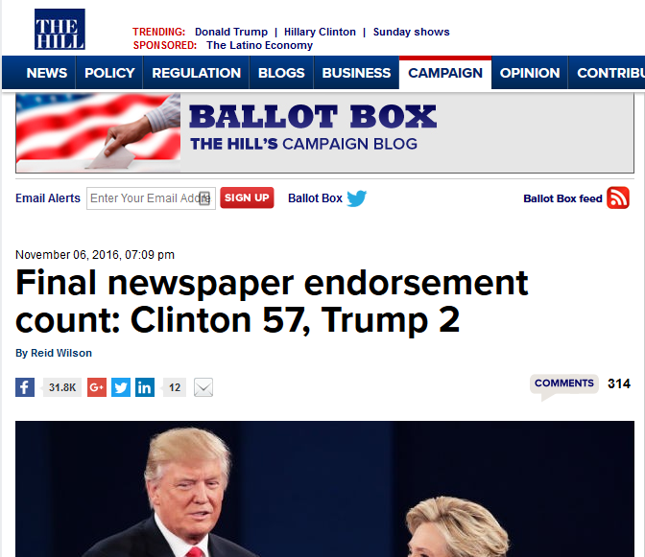
newspaper endorsements
Source: Thehill.com

Slide 8
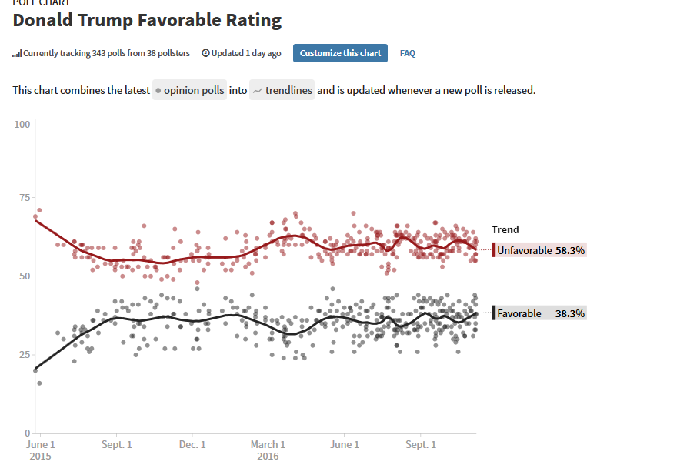
Trump favorability
Source: pollster.com

Slide 9
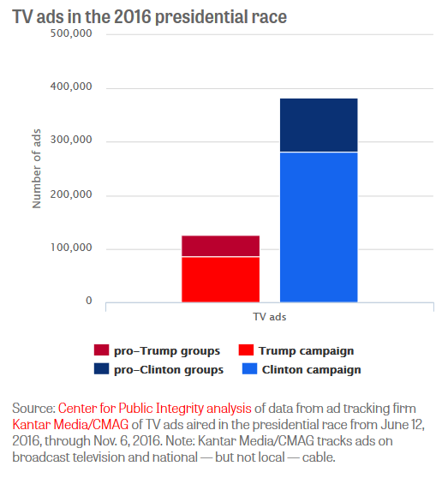
ads
Team Clinton aired three times as many ads as Team Trump

Slide 10
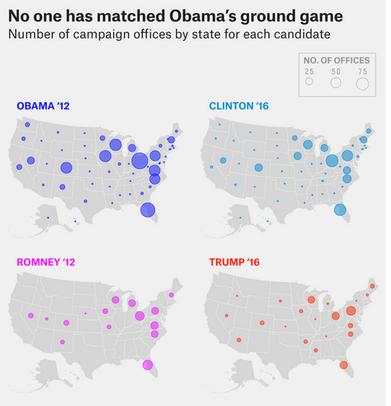
field offices
Clinton had more than twice as many field offices as Trump
Source: fivethirtyeight.com

Slide 11
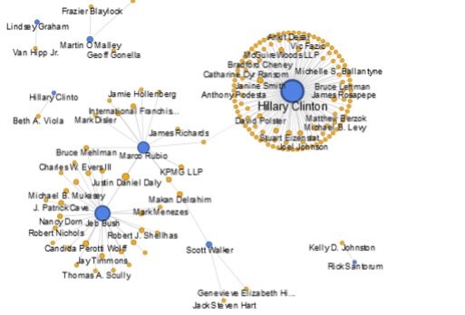
Lobbyist Donors to Presidential Candidates
Lobbyists coordinated on Clinton more than any other candidate
Source: Center for Responsive Politics, opensecrets.org

Slide 12
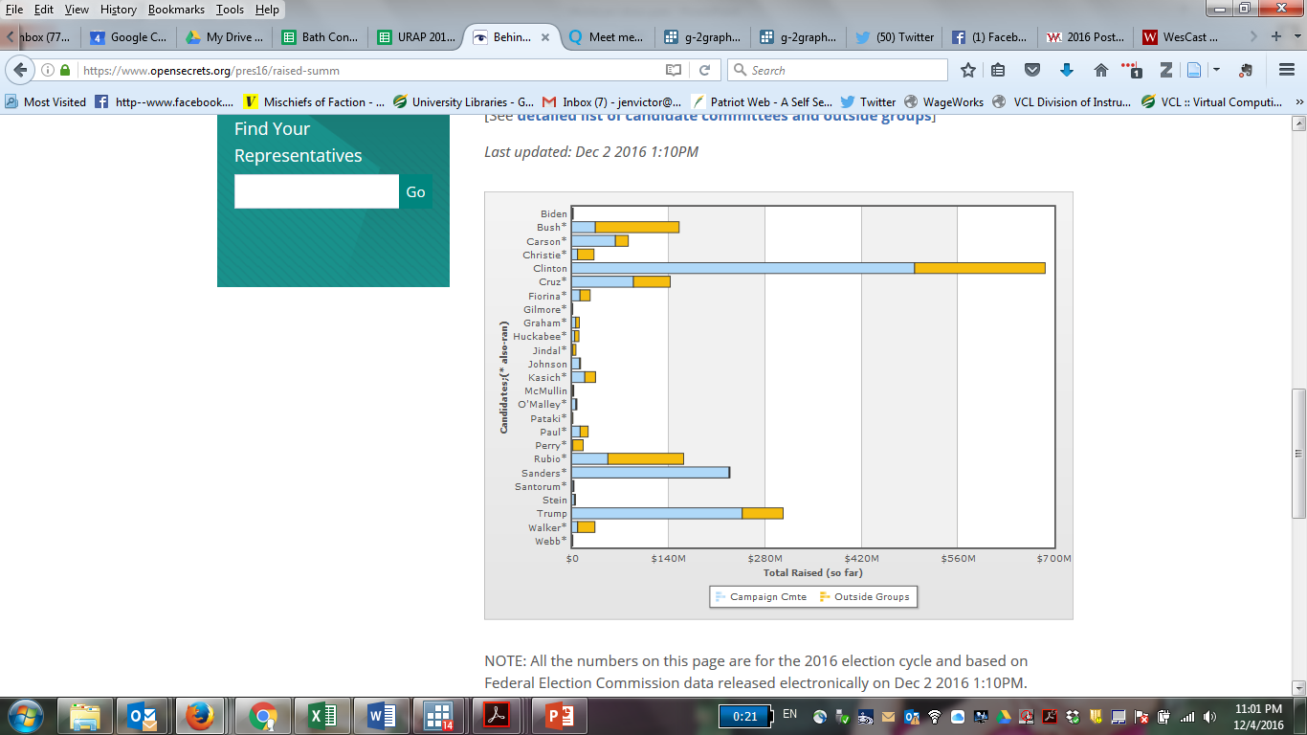
Clinton raise, spent, and attracted more money
Source: Center for Responsive Politics, opensecrets.org

Slide 13
Spending and Vote share: Presidential
Spending is positively correlated with vote share.

Slide 14
Spending and Vote share: Senate
Spending is positively correlated with vote share.

Slide 15
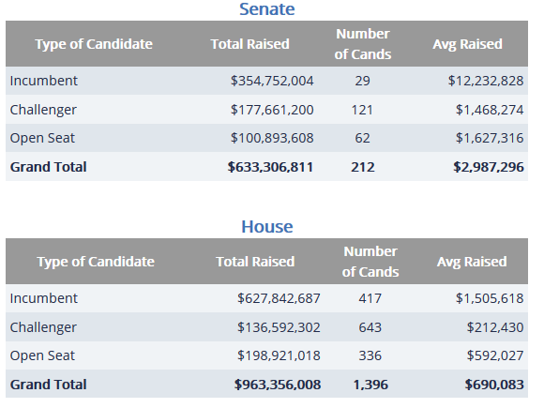
What do Campaign Receipts Tell Us?
Winning candidates tend to have more money, but candidates may not buy elections because:
  Incumbents tend to win
  Incumbents have an easier time raising money
  Incumbents need less money than challengers to win
  Donors and candidates tend to share ideology
Money signals popularity and strength
Source: Center for Responsive Politics, opensecrets.org

Slide 16
Breaking the rules
Typically, campaign receipts tell us about candidates’
  Popularity
  Loyalties
  Constituencies
The receipts from the presidential winner this year is not revealing.
One big difference: earned media

Slide 17
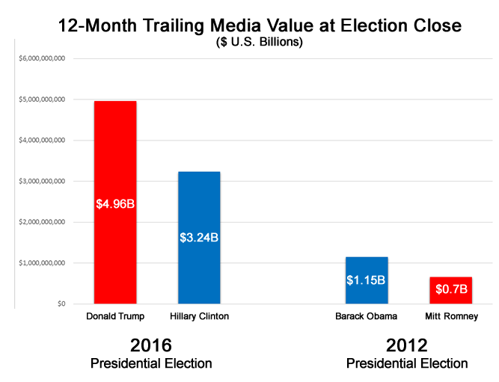
Earned media Takes over
Source: MediaQuant

Slide 18
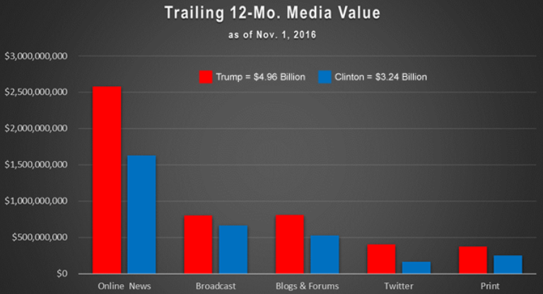
Trump earned media swamps Clinton
Across all categories, Trump earns more media
Source: MediaQuant

Slide 19
Media Value and Vote share*
Media value is negatively associated with vote share.
2016 both candidates are famous and have high unfavorable.
*Relationship based on only two election cycles ; 2016 is weird in many ways

Slide 20
Campaign finance Landscape
Changes in campaign finance laws have contributed to:
  Opportunities for outside candidates
  Partisan polarization
  Increased participation by monied interests
  The “privatization” of campaign funding

Slide 21
Campaign Finance Laws
1947 Taft-Hartley Act bans corporate and labor contributions
1971 Federal Election Campaign Act (FECA) sets campaign contribution & expenditure limits
1975 FEC Sunoil decision => PAC explosion
1976 Buckley v. Valeo: expenditure limits violate free speech; money is speech
1980s & 1990s “Soft money” becomes common
2002 Bipartisan Campaign Finance Reform Act (BCRA) bans soft money, increases limits on direct contributions
2010 Citizens United v. FEC: lifts restrictions on corporate spending
2010 Speechnow v. FEC allows unlimited contributions to outside groups
2014 McCutcheon v. FEC strikes down overall campaign contribution limits

Slide 22
Money Channels
HARD MONEY
Direct contributions to candidates (limited and reported)
Direct contributions to parties and PACs (limited and reported)
SOFT MONEY
501(c) Non-profit outside groups, unlimited and non-reported
Super PACs Can raise and spend unlimited for candidates, must report donors
LLCs unregulated

Slide 23
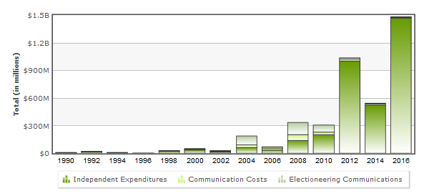
Outside spending explosion
In 2016 in 33 Congressional races outside groups spent more than candidate campaigns.
Of top 10 Senate races in 2014, nearly 60% of money was from outside groups.
Source: Center for Responsive Politics, opensecrets.org

Slide 24
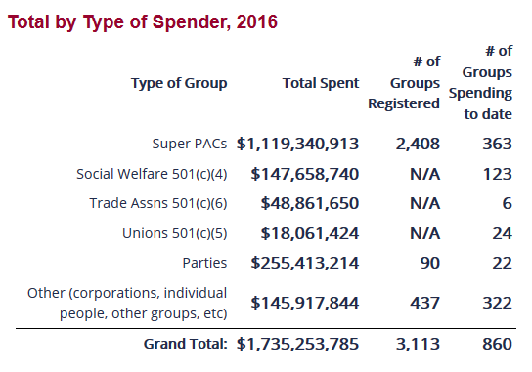
Outside spending
Super PACs grow after 2010.
“Dark Money” grows in the recent cycle mostly through 501(c)s
Source: Center for Responsive Politics, opensecrets.org

Slide 25
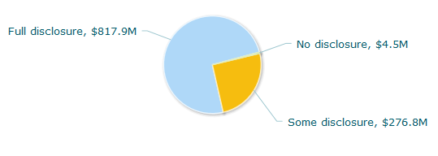
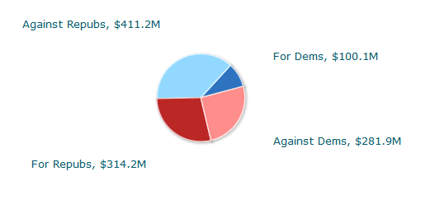
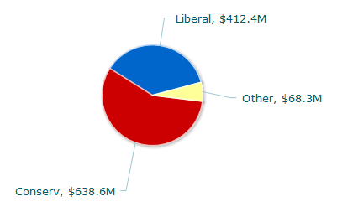
Super PACs
By Disclosure
By Recipient Party
By Group Ideology
Source: Center for Responsive Politics, opensecrets.org

Slide 26
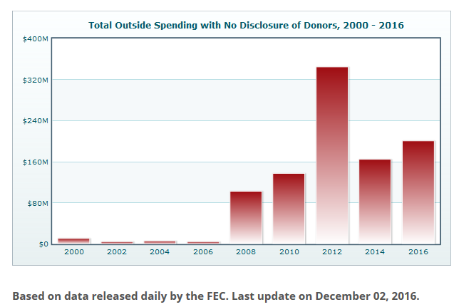
Dark money explosion*
In first year of 2016 cycle dark money was 10x more than it was at the same point in 2012
*2016 will not be updated until sometime in 2017 when IRS disclosures are available
Source: Center for Responsive Politics, opensecrets.org

Slide 27
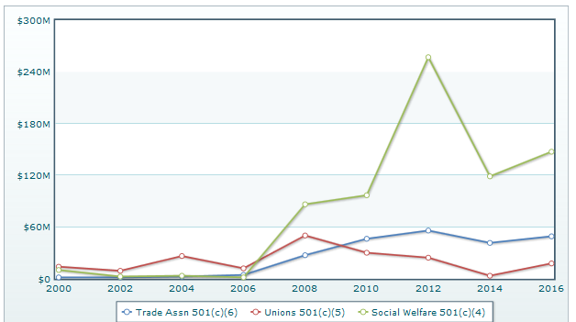
Dark money explosion*
*2016 will not be updated until sometime in 2017 when IRS disclosures are available
Source: Center for Responsive Politics, opensecrets.org

Slide 28
implications
Quantifiable, dynamic indicators point toward Clinton advantage
Fundamentals point to moderate Trump advantage
Institutions matter
  Electoral college elevates importance of votes from low population areas
  Campaign Finance landscape creates incentives for outsiders to donate and run
  Finance laws weaken party apparatus creating opportunities for unconventional candidates
  Elections outsourced to highest bidders
  These changes contribute to partisan polarization

Slide 29
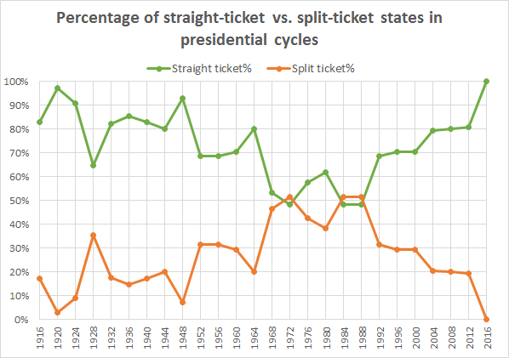
Source: Crystalball, Larry Sabato

Slide 30
Implications
In a system where money flows from centralized sources, it is predictive of outcomes.
In a system where financing is decentralized, money is less coordinated and contributes to determining outcomes.
If unconventional candidates follow Trump’s example and win, then 2016 broke campaign finance.
But it’s just as likely that campaign finance broke 2016.

Slide 31
EXTRA SLIDES

Slide 32
The Farmer’s Revolt OR the Democrats’ malaise
How elections are won:
  Turnout. Turnout. Turnout.
  Republicans were more enthusiastic about their nominee than Democrats were about theirs.
  Compare to 2012

Slide 33
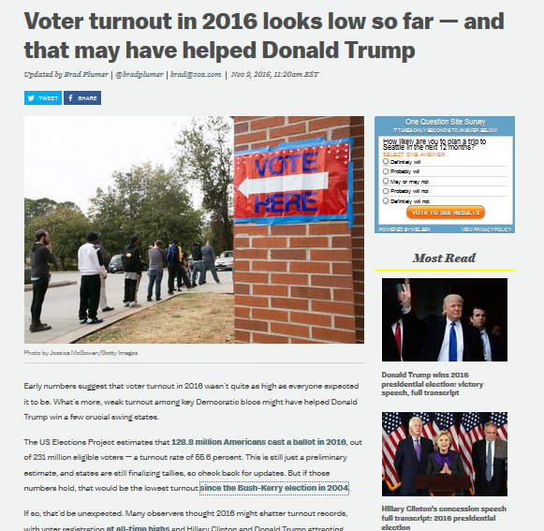
2016 Turnout was low
Source: @bradplumer Vox.com

Slide 34
2016 voter turnout favored Republicans. Democrats did not engage like they did in 2012.
Source: CNN

Slide 35
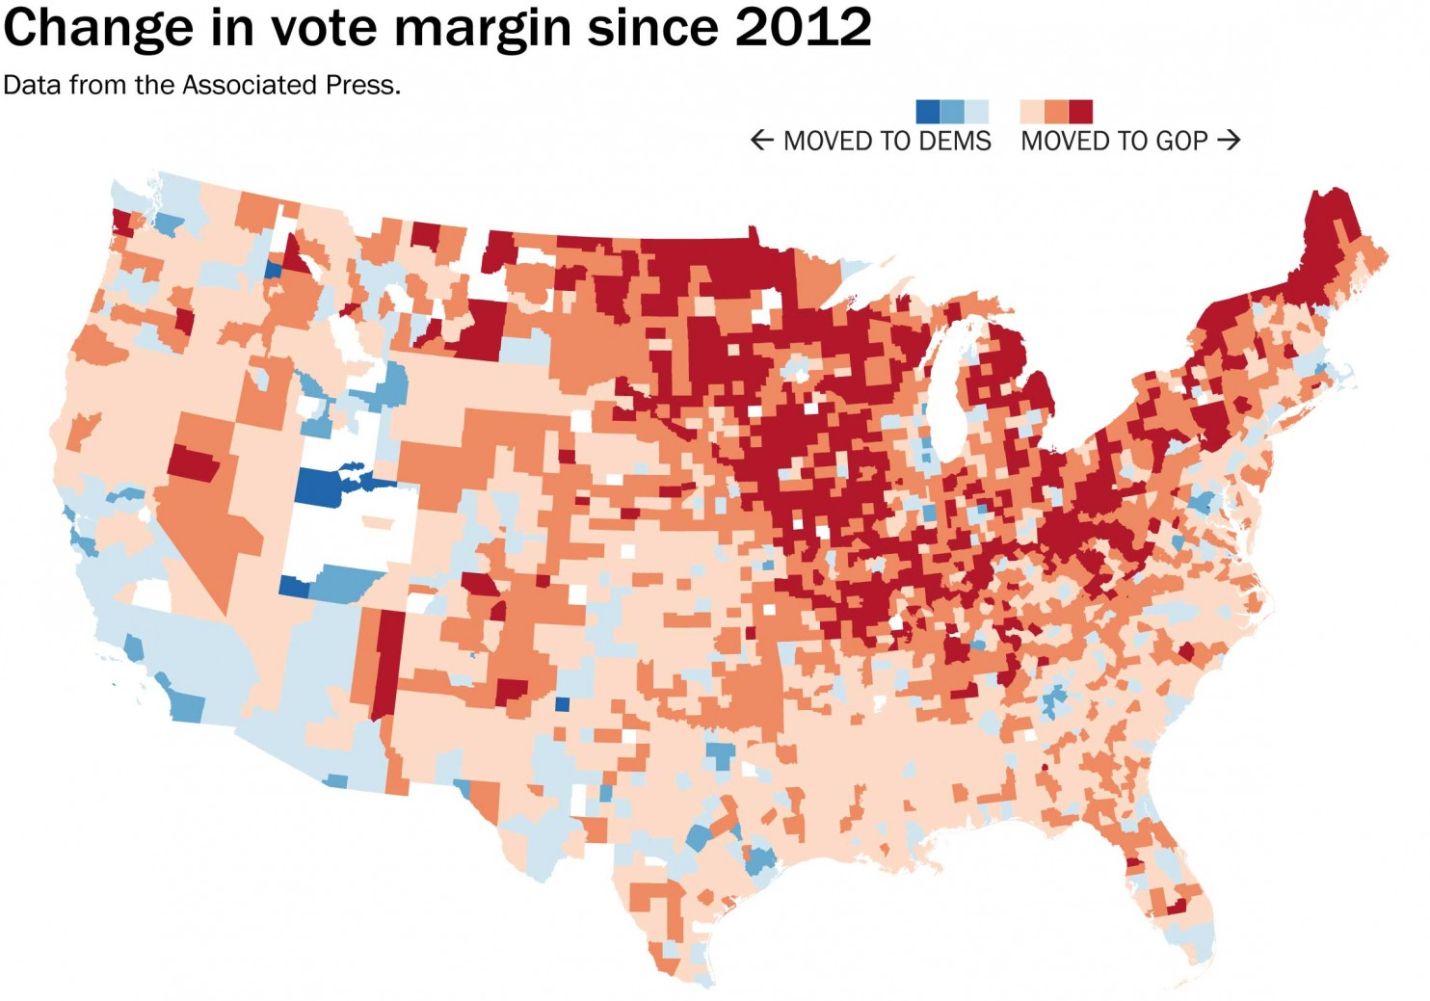
Older, white, Northerners moving to Republicans; nonwhite Southwest moving to Democrats
Source: Washington Post/ Associated press

Slide 36
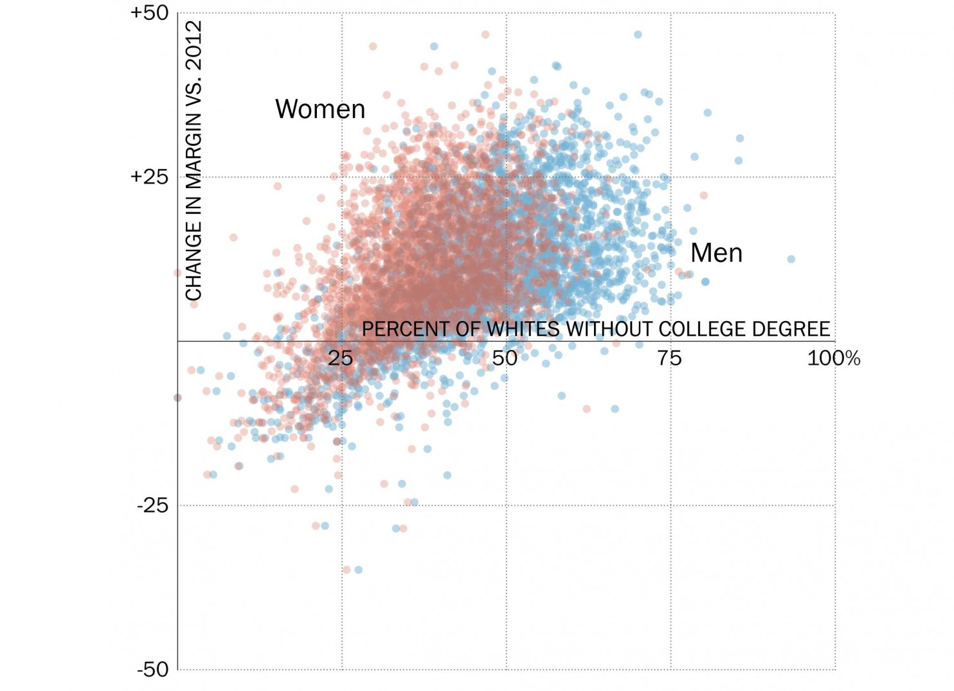
Non-college educated whites turned out, compared to 2012
The greater the density of whites without a college degree, the greater the swing to Trump, versus 2012.
Source: Washington Post/ Associated press

Slide 37
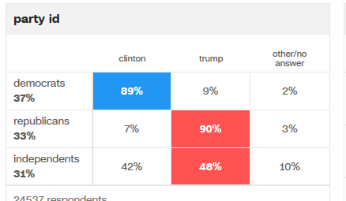
How have our politics changed
Parties are weak
  Republican elites failed to prevent an outsider from gaining their parties nomination
Partisanship is strong
Unusual & dangerous combination
Source: @Julia_azari, Mischiefs of Faction on Vox.com
CNN exit polls

Slide 38
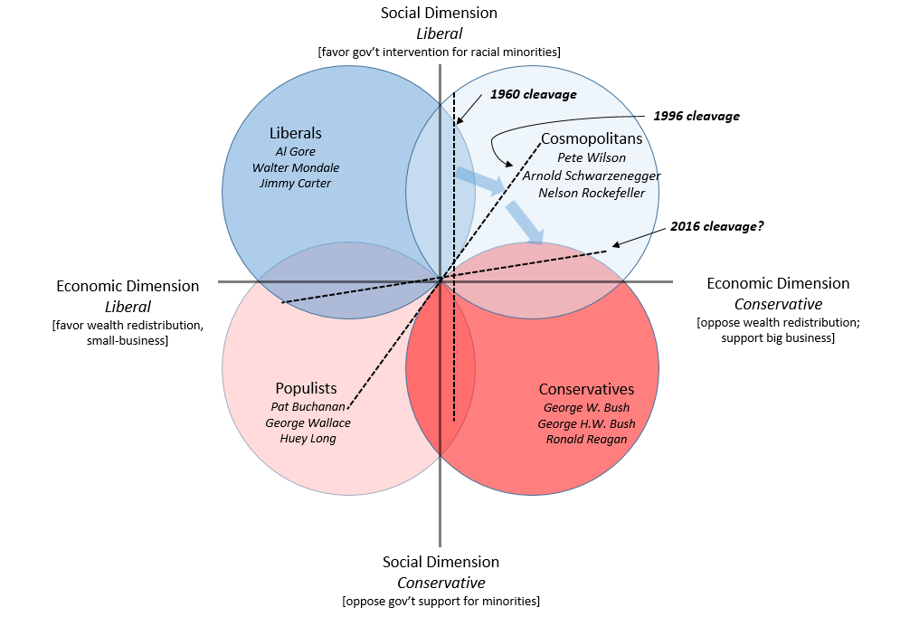
How our politics have changed: parties II
2016: Social/racial dimension grows in importance
Predict: Blue party begins to adopt more economic conservative policies (trade?)
Are parties realigning their voter coalitions?
Predict: Red party becomes more populist
Source: @jennifernvictor, Mischiefs of Faction on Vox.com

