Slide 1
How Moral Language Does the Work of Politics
Keena Lipsitz
Queens College and The Graduate Center

Slide 2
Research Question & Data
Questions:
Do Republican and Democratic elites use distinctive moral language?
If they do, is this a way candidates “pivot” from the primary to the general election?
How does moral language affect voters?
Data
Advertising data from the Wesleyan Media Project
Survey data from the 2012 Vanderbilt/YouGov Ad Rating Project

Slide 3
What is Moral Language?
Moral Foundations Theory (Haidt and Joseph 2004)
Originally developed to describe moral differences across cultures
Argues most values or “foundations” are universally shared but that socialization teaches us to emphasize certain values more than other
Identified six values thus far: Authority, Loyalty, Sanctity, Liberty, Care, Fairness
MFT is a useful place to start

Slide 4
What is Moral Language?
MFT has been used to understand political differences in the United States
Liberals value Care and Fairness more while conservatives emphasize Authority, Loyalty, Liberty, and Sanctity (Graham et al. 2009; Haidt 2013; Haidt and Graham 2007; Haidt and Hersh 2006)
Moral values stronger predictor of “culture war” related attitudes more ideology (Koleva et al. 2012)
Libertarians focus almost exclusively on Liberty (Iyer et al. 2012)

Slide 5
Moral Appeals as Emotional Appeals
Moral intuitions allow individuals to make snap judgments without much thought
Makes them an attractive target for political elites who are trying to shape public opinion
Use them to appeal to emotions

Slide 6
Hypotheses
Republican and Democratic elites will emphasize different values in their communications
Will be more pronounced in primaries
Candidates will moderate their language in the general election
These appeals will evoke an emotional reaction

Slide 7
Study 1
Presidential primary ads from 2008 and 2016
Using Moral Foundations Dictionary to analyze text of political advertisements
Use correspondence analysis
Graphically depicts the relationship between variables in a contingency table
Moral values and candidates that lie in the same direction from the origin are associated with one another
Distance from origin indicates how unique a value or candidate is

Slide 8
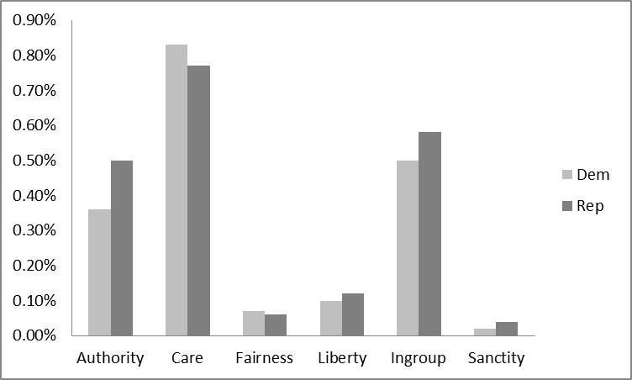
Non-Presidential Ads: 2008

Slide 9
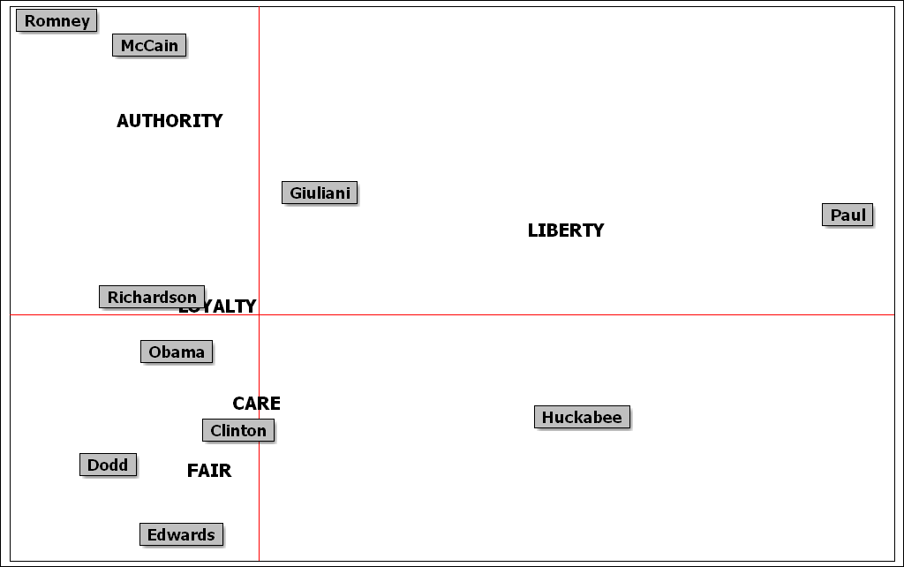
Presidential Primary Candidate Ads: 2008

Slide 10
Presidential Primary Candidates: 2016

Slide 11
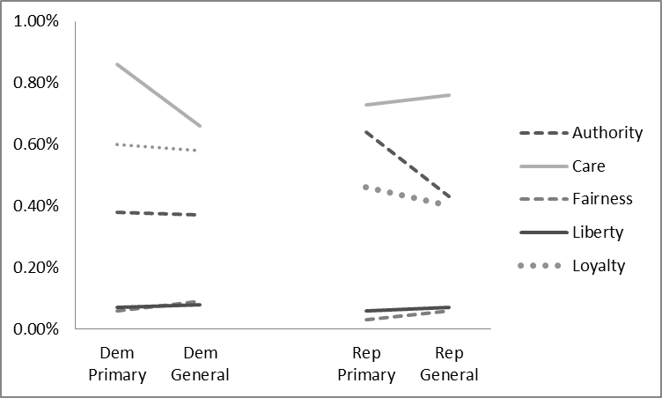
Change in Moral Language from Primary to General: 2008

Slide 12
Study 2
2012 Vanderbilt/YouGov Advertising Data
28 Ads
Coded using Moral Foundations Dictionary
Nationally representative samples of 600 voters
Variety of dependent variables
“Interesting,” “memorable, “ “truthful,” and “believable”
Like ad?
Emotional response: “angry,” “worried,” “disgusted,” “happy,” “hopeful”

Slide 13
