Slide 1
GENDER, feminism, the 2016 Presidential Election and beyond
Leonie Huddy
Department of Political Science

Slide 2

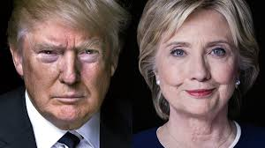
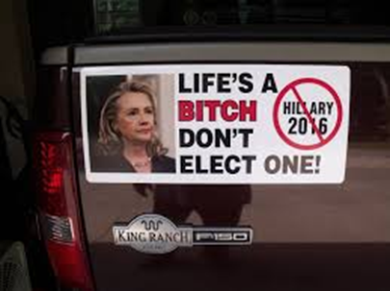
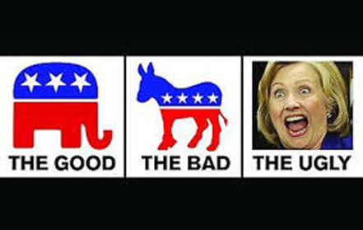
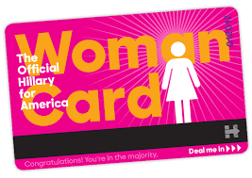
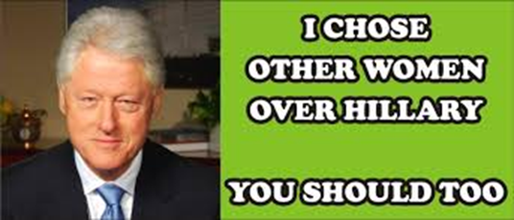
candidate gender salient in 2016

Slide 3
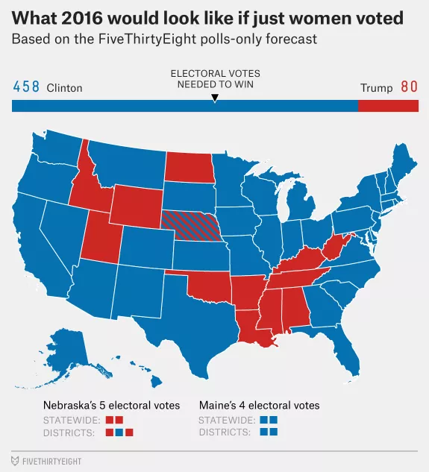
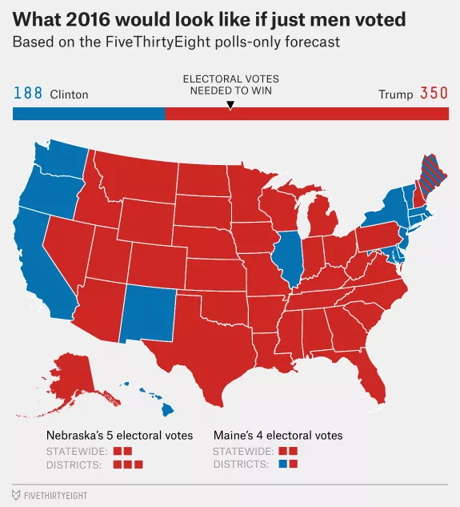
women were expected to support Hillary Clinton: the gender gap

Slide 4
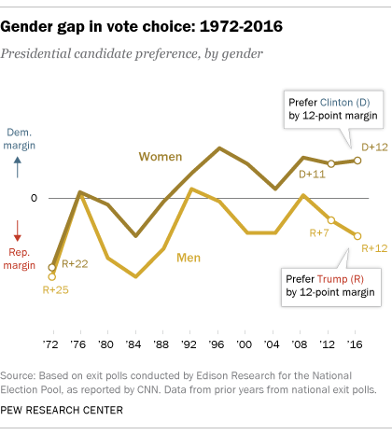
Large gender gap in 2016
Large gender gap in 2016
The Gender Gap (% women voting for Dem -% men voting for Dem) = 13 pts.
Fewer men voted for Clinton than Obama; but the election outcome is not historically unprecedented
Raises questions about normalcy or extraordinariness of 2016

Slide 5
Placing gender in political context:
Women are not a unified voting bloc
Gendered loyalties are complex
  Men and women are highly interdependent, making gender a complex social category politically
Partisanship and vote choice are not simply grounded in gender
  Many men are Democrats and many women are Republicans
  There is a gender gap in partisanship but it is relatively modest in size (6-12 % points in recent presidential elections)

Slide 6
The Feminist gap
Feminist gendered ideology
There is no widely accepted version of this concept. Typically measured by some mix of the following items:
  Equal gender roles
  Perceived inequality
  Feelings toward feminists
  An emotional bond with women
Have some of the best measurement in the 2012 ANES
  2012 ANES F2F (N=2,054) and internet (N=3,860)
  Large oversamples of blacks and Latinos in both samples

Slide 7
Feminist Ideology in 2012: 4 components
2012 American National Election Studies
F2F (N=2,054) and internet (N=3,860)
Large oversamples of blacks and Latinos in both samples
Feminist Identity and Antipathy (1 item)
Feeling thermometer rating of feminists (good distribution)
Perceived Discrimination Against Women (4 items)
How serious a problem is discrimination against women in the United States? (modern sexism)
Gender Resentment (2 items)
When women demand equality these days, how often are they actually seeking special favors? (from modern sexism)
Importance of Female Political Representation (2 items)
How important is it to you that a woman is or is not elected President of the United States?
Measurement Model: The four factors are distinct but form a strong common factor
The structure is invariant across age, race, gender and interview mode

Slide 8
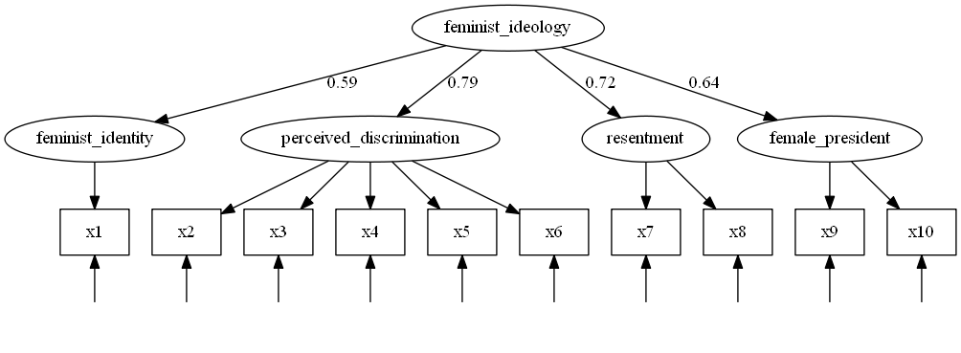
Structure of Feminist Ideology

Slide 9
Distribution of Feminist Ideology by Gender
(Kernel density plot)
0-1 scale overall; created by additively combining all four component scales (which are created in turn by additively combining their items)
Modest gender gap
Marked diversity among both women and men

Slide 10
Determinants of Feminist Ideology
 | Men |  |  | Women
Traditional Beliefs
Women's Roles (non-traditional) | 0.05 | (0.02) | * | 0.02 | (0.02)
Traditional Moral Values | -0.18 | (0.02) | ** | -0.13 | (0.02) | **
Religious Attendance | 0.01 | (0.01) |  | 0.00 | (0.01)
Political Orientation
Conservative-Liberal Ideology | 0.14 | (0.02) | ** | 0.16 | (0.01) | **
Personality Factors
Authoritarian | -0.02 | (0.01) | * | -0.01 | (0.01)
Open to Experience | 0.02 | (0.02) |  | 0.09 | (0.02) | **
Agreeable | 0.08 | (0.02) | ** | 0.05 | (0.02) | *
Education | 0.00 | (0.01) |  | 0.04 | (0.01) | **
N | 2581 |  |  | 2724
R² | 0.31 |  |  | 0.32

Slide 11
Feminism by Openness to Experience
This is drawn form an equation in which political ideology, traditional morality, and beliefs about the size of government are controlled.

Slide 12
Effects of Feminist Ideology on Partisan Polarization=Dems-Reps
(-1 to +1)
 | Polarization
Gender (female: feminism=0) | -0.11 | (0.05) | *
Ideology
Strong Government | 0.36 | (0.02) | **
Traditional Moral Values | -0.26 | (0.03) | **
Religious Attendance | -0.04 | (0.02) | *
Conservative-Liberal Ideology | 0.67 | (0.04) | **
Group-Based Attitudes
Racial Resentment (Non-Black) | -0.15 | (0.03) | **
Black X Resentment | 0.18 | (0.09) | *
Feminism (among men) | 0.29 | (0.07) | **
Female X Feminism | 0.18 | (0.09) | *
N | 5273
R² | .56
Entries are regression coefficients with standard errors in parentheses.
Notes:
Interaction only occurs for whites, men and women among blacks and Latinos

Slide 13
Marginal Effect of Feminist Beliefs on Partisan Polarization among Men and Women:

Slide 14
The 2016 election outcome
Men
Women

Slide 15
Bothered by TRUMP’S TREATMENT OF WOMEN?
% support for trump
Women
Men

Slide 16
Concluding Thoughts
Partisans voted along partisan lines in 2016
Feminism is a large part of that decision
The question concerns the additional role played by gender in 2016
  Did hostile sexism play an added role and drive support for Trump?
  Were there heightened effects of feminism (among women and men)?
What does this mean for a future female political candidate?
  Most likely to emerge within the democratic party
  But may be easier to win if on the political right (decreasing the effects of sexism and snit-feminism)?

Slide 17
Thank you!
Leonie.huddy@stonybrook.edu

