Slide 1
The Future of the Supreme Court and Lower Federal Courts
Paul M. Collins, Jr.
Professor and Director of Legal Studies
University of Massachusetts Amherst

Slide 2
Vacancies on the Federal Courts (as of 11/30/16)
Court | Vacancies | Pending Nominations
Supreme Court | 1 | 1
Courts of Appeals | 13 | 7
District Courts | 83 | 44
Other Courts | 8 | 7
Total | 105 | 59

Slide 3
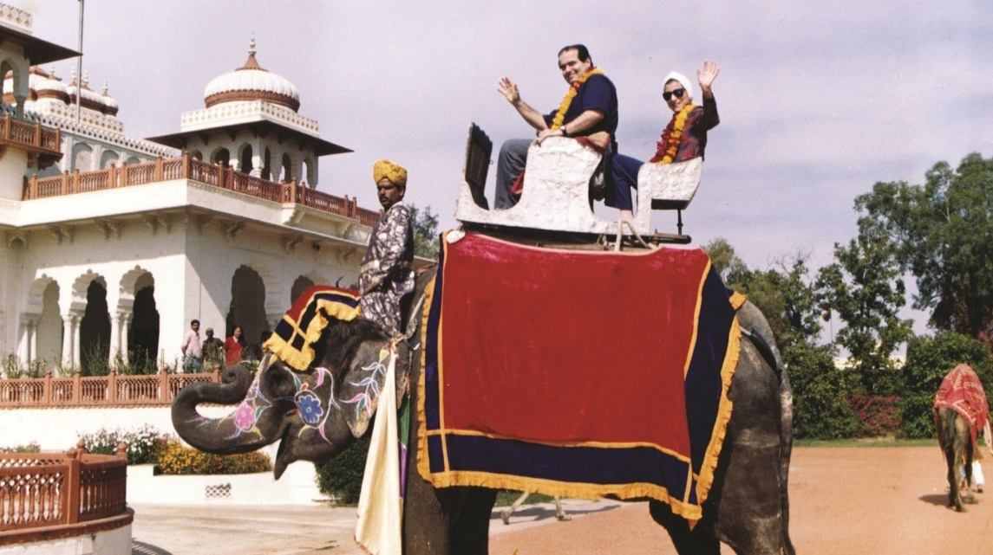
Antonin Scalia
Served for 30 years
A reliable conservative vote
Frequently criticized by liberals
An outspoken advocate of “originalism”

Slide 4
Ideological Voting on the Current Supreme Court (through 2014 term)

Slide 5
So What’s at Stake?
For liberals – the dream of having a liberal majority on the Supreme Court for the first time in almost 50 years
For conservatives – the chance to replace Scalia with a similarly conservative justice

Slide 6
Plus, the possibility of other appointments
Name | Age | Years of Service | Party
Ginsburg | 83 | 23 | Democratic
Kennedy | 80 | 28 | Republican
Breyer | 78 | 22 | Democratic
Thomas | 68 | 25 | Republican
Alito | 66 | 10 | Republican
Sotomayor | 62 | 7 | Democratic
Roberts | 61 | 11 | Republican
Kagan | 56 | 6 | Democratic

Slide 7
What Should We Expect from Trump’s Nominees?
With Some Certainty:
They will be conservative
With Less Certainty:
Where the nominees will come from
Whether they will add diversity to the courts
Whether they fit into the “constitutional mainstream”
Whether they will respect existing precedents

Slide 8
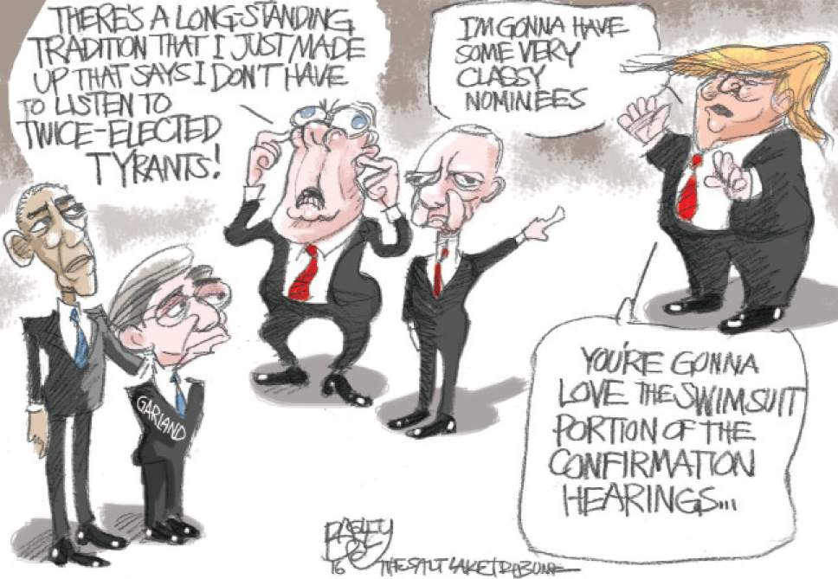
Thank You!

Slide 9
Characteristics of US Supreme Court Justices
Name | Born | Appointed | Party | Law School | Appointing President | Religion | Prior Judicial Experience | Prior Government Experience
John G. Roberts | 1955 | 2005 | Rep. | Harvard | Bush (G.W.) | Roman Catholic | U.S. Court Of Appeals | Principle Deputy Solicitor General
Antonin Scalia | 1936 | 1986 | Rep. | Harvard | Reagan | Roman Catholic | U.S. Court Of Appeals | U.S. Assistant Attorney General
Anthony Kennedy | 1936 | 1988 | Rep. | Harvard | Reagan | Roman Catholic | U.S. Court Of Appeals
Clarence Thomas | 1948 | 1991 | Rep. | Yale | Bush (H.W.) | Roman Catholic | U.S. Court Of Appeals | Chair, Equal Employment Opportunity Commission
Ruth Bader Ginsburg | 1933 | 1993 | Dem. | Columbia | Clinton | Jewish | U.S. Court Of Appeals
Stephen Breyer | 1938 | 1994 | Dem. | Harvard | Clinton | Jewish | U.S. Court Of Appeals | Commissioner, U.S. Sentencing Commission
Samuel Alito | 1945 | 2005 | Rep. | Yale | Bush (G.W.) | Roman Catholic | U.S. Court of Appeals | U.S. Attorney Asst. Solicitor General
Sonia Sotomayor | 1954 | 2009 | Dem. | Yale | Obama | Roman Catholic | U.S. Court of Appeals | New York County District Attorney
Elena Kagan | 1960 | 2010 | Dem. | Harvard | Obama | Jewish |  | U.S. Solicitor General

Slide 10
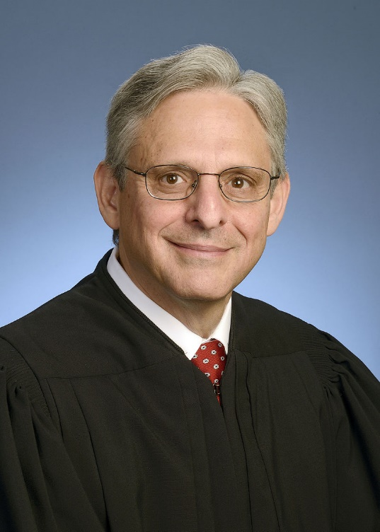
Merrick Garland
Appointed by Obama on March 16, 2016
A very traditional nominee:
Age: 63
Party: Democrat
Law School: Harvard
Religion: Jewish
Prior Judicial Experience: US Court of Appeals
Prior Government Experience: Special Assistant to the US Attorney General, Assistant US Attorney, Deputy Assistant US Attorney General
Ideology: Moderate liberal

